Slide 1
Individual homework
Vescan Antonia

Slide 2
Problem statement
Exercise 3.7
Using the semantic tableaux method, decide whether the following logical consequences hold or not. If a logical consequence does not hold find an anti-model of it.
p Λ ( q → r ), q V r ╞ p → (q → r)

Slide 3
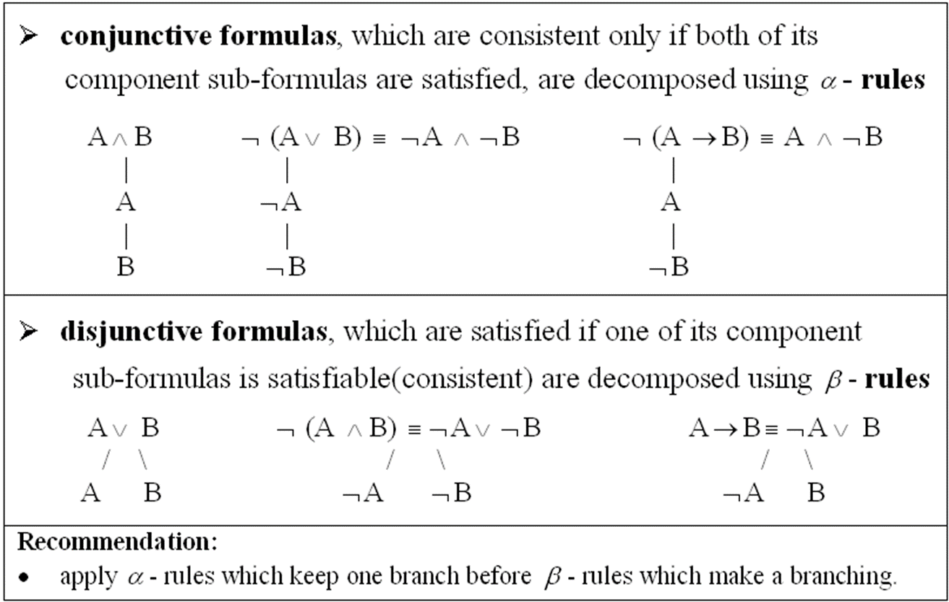
Theoretical Results
Semantic Tableaux Method
It is based on semantic considerations => semantic method.
Its basic aim is to decide consistency and to find all the models of a formula by decomposing the formula in sub formulas.
The validity of a formula is proved by contradiction => refutation method.
Decomposition rules for
propositional formulas:

Slide 4
p Λ ( q → r ), q V r ╞ p → (q → r) if and only if
(p Λ ( q → r )) Λ ( q V r ) Λ ┐( p → (q → r)) has a closed semantic tableaux
(p Λ ( q → r )) Λ ( q V r ) Λ ┐ ( p → (q → r)) (1)
p
( q → r ) (2)
q V r (3)
┐ ( p → (q → r)) (4)
p
┐(q → r) (5)
q
┐r
┐q r
q r
α rule for (1)
α rule for (4)
α rule for (5)
β rule for (2)
β rule for (3)
Closed branch
Closed branch
Closed branch

Slide 5
Conclusion
This is a complete and closed tableau with three closed branches containing the following pairs of opposite literals (┐r, r), (┐ q, q), (┐r, r). Therefore the logical consequence holds.

